Slide 1
Your Employee Assistance Program
CNIC
Notes:
Introduce yourself as a representative of ACI Specialty Benefits.
Today’s training is to introduce you to the NEW and comprehensive Employee Assistance Program for CNIC employees and your family members beginning (date). ACI is very excited to provide a full range of EAP services which also include comprehensive work/life and personal services. It is ACI’s goal for all employees and their family members to be fully aware of these new benefits.

Slide 2
Purpose & Objectives
This orientation is designed to help you:
Better understand your Employee Assistance Program (EAP)
How & When to access your EAP Benefits
Notes:
State the Purpose and Objective of the presentation. This presentation is tailored to help employees and their family members understand the EAP, how and when to access the EAP, and how best to utilize the EAP. There are multiple components of the EAP Benefit, the Mental Health aspect, and a Work/Life and personal services portion.

Slide 3
Why use the EAP?
Mental Health
Marriage & family conflicts
Substance abuse
Stress management
Emotional challenges
Health concerns
Grief and loss
Work/Life
Childcare Referrals
Eldercare Referrals
Legal Consultation
Financial Consultation
Notes:
ACI is different from most EAPs in which we offer Mental Health services and a Work/Life benefit portion to the employees and family members.
Why use the EAP?
When employees or family members can’t manage their emotions or circumstances on their own, they can utilize their EAP benefits to assist them.
Mental Health can include, but is not limited to:
Marriage & family conflicts.
Substance abuse.
Stress management.
Emotional challenges.
Health concerns.
Grief and loss.
Regarding the Work/life portion of the EAP, ACI provides Work/Life benefits that assist the employee or family member from further stress or time off of work, ACI providers services that can assist with referrals for children, eldercare, legal and financial consultation. Information will follow.

Slide 4
EAP Sessions
Employees and Family members are authorized for:
5 sessions per issue are provided by your employer
EAP is a short-term approach for
assessment,
diagnosis, referral, and/or
short term problem resolution
Notes:
Mental Health sessions are provided by the Company for employees and family members. The employees and family members of your company are authorized for a number of sessions paid for by your employer. The sessions are for assessment, diagnosis, and referral or short-term problem resolution.
Providers may self refer or refer to someone on their insurance plan if they are not. For more information on your EAP benefit, please contact ACI directly or contact the HR Department.

Slide 5
24 Hours
Licensed mental health professionals are always available for after-hours calls.
On-call counselors are ready and waiting.
This is not an Emergency Number. Call 911 if there is an emergency.
Business Hours:
PST – 7:00 a.m. – 5:30 p.m.
CST – 9:00 a.m. – 7:30 p.m.
EST – 10:00 a.m. – 8:30 p.m.
Notes:
ACI prides itself in providing quality Customer Service. For example, when an employee calls the (800) number, ACI will guarantee that they will be assisted or spoken to by a person. ACI does not believe in automated answering services. This helps convey to the employee and family members that we are here to assist and speak with them to find the appropriate service.
ACI has live operators even after business hours who are trained to obtain important and relevant information from the caller to determine whether to take a message to be followed up with the following business day or to connect the caller immediately with a licensed mental health professional.
For Life threatening cases, such as a suicide or where someone wants to cause harm to themselves or others, please call 911 or call the nearest emergency center.
FAQ
Where is ACI located?
ACI’s Corporate headquarters is in San Diego, CA.
What are the business hours?
General business hours are Monday through Thursday 7:00 AM – 5:30 PM PST, Friday from 7:00 AM – 4:30 PM.

Slide 6
All Family Members
We mean all family members. Living in the same state with you or not.
All are welcome:
Children
Spouses
Significant Others
Parents
Grandparents
Your definition of family is ACI’s definition of family.
Notes:
ACI provides services to employees, family members, and significant others. Your definition of family is ACI’s definition of family.
The EAP is available to assist an employee in addressing problems that may take away their attention from work. An example would be; if an employee works in Millington, TN and they have a parent or a family member in “Minnesota,” they too are covered under the EAP services through ACI. *The family member would simply need to call the (800) number and inform the intake operator that they have a family member that works for the CNIC . and they to would like to utilize the EAP services.
* If they are unsure as to what benefits they are entitled to, they can also call the (800) number and inform the intake operator that they need some information or visit the company’s landing page.

Slide 7
Multi-Cultural/ Multi-Lingual
All ethnic concerns accommodated
All cultural issues addressed
All special interests acknowledged
Multilingual services available
Notes:
For extended families and those family members that speak different languages such as Spanish, French, Tagalog (pronounced tah-gah-lawg), or Chinese to name a few.
ACI has trained professionals to take calls in a variety of different languages. ACI’s services include access to speaking with someone in over 150 different languages to help better serve.
ACI provides clinicians that are culturally sensitive and multi-lingual. Providers are available in person or by telephonic assessment if needed.

Slide 8
Many Locations
Just tell the intake person where the most convenient location is for you to be seen:
Near Work
Near Home
Or in between
Notes:
ACI serves many locations and has a network of over 40,000 clinician nationally and internationally. If you have a loved one in another city or across the country, ACI can provide services to them as well.

Slide 9
Comprehensive Work/Life
Work/Life Management Solutions offer an innovative blend of referral services designed to make life easier
Childcare Referrals
Eldercare Referrals
Pet Care Referrals
Legal Service
Financial Services
Identity Theft
Educational Assistance Referrals
Notes:
In addition to the Mental Health portion of the EAP, Employees and Family Members also have a Comprehensive Work/Life aspect with lots of resources and information. These include Childcare, Eldercare, Legal, Financial referrals and much more.

Slide 10
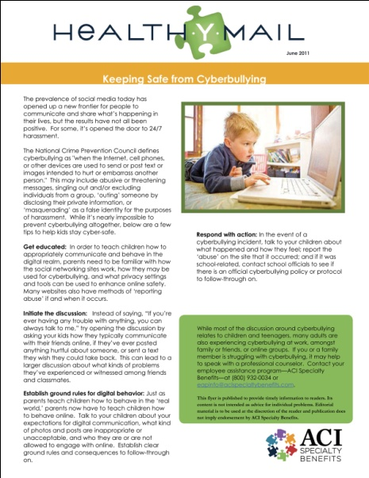
Healthy Literature
Information is available to you
HealthYMail Monthly Newsletters
Affinity Quarterly Newsletters
Notes:
In addition to the Work/Life and Mental Health portions of the EAP, ACI provides information is available to you on any issue of concern on a variety of topics. ACI provides a Healthy Mail newsletter every month with different healthy topics each month and quarter. The newsletters are provided to Human Resources or the benefits department in which they distribute to the employees.

Slide 11
Personal Services & Community-based Resources
Information and referrals are provided for but not limited to:
Home Repairs
House Cleaning Service
Entertainment events
Landscaping Services
Ridesharing Programs
ACI is here to help!
Notes:
ACI Personal Services is like having your own personal attendant! Contact ACI to assist you with things like finding a licensed and bonded plumber or roofer, house cleaning services or local ride sharing programs.

Slide 12
Confidential
All information provided is protected
No information gets back to the company
The utilization report has no names on it
Notes:
All information provided by the employee and family member is protected by State and Federal Law. No employee information will be on the utilization report for the company to see. All information is confidential.

Slide 13
EAP in Summary
Allows you to address stress related issues early on
Reduces the risk of you having to take time off from work
Facilitates good mental health
Shows that the company is committed to your overall well being
Notes:
To summarize the EAP benefits offered to the employees and their family members of the CNIC. the EAP:
Promotes early intervention for you to attack stress related issues early.
Reduces your risk of being absent from work to deal with stress related personal matters.
Facilitates good mental health which reduces your overall health care costs.
The EAP benefits shows the company’s commitment to your well being.

Slide 14
Employee Landing Page
Your company’s landing page gives employees a brief overview of the EAP benefits and gives you access to:
Benefits summary
Links to resource web portals
EAP brochure & announcement flyer
http://cnic.acieap.com
Notes:
The landing page is the employees’ EAP overview. It will be an easy way for employees and their family members to have all the information they need about their new EAP benefit. This link is live now and we encourage you to use it regularly.

Slide 15
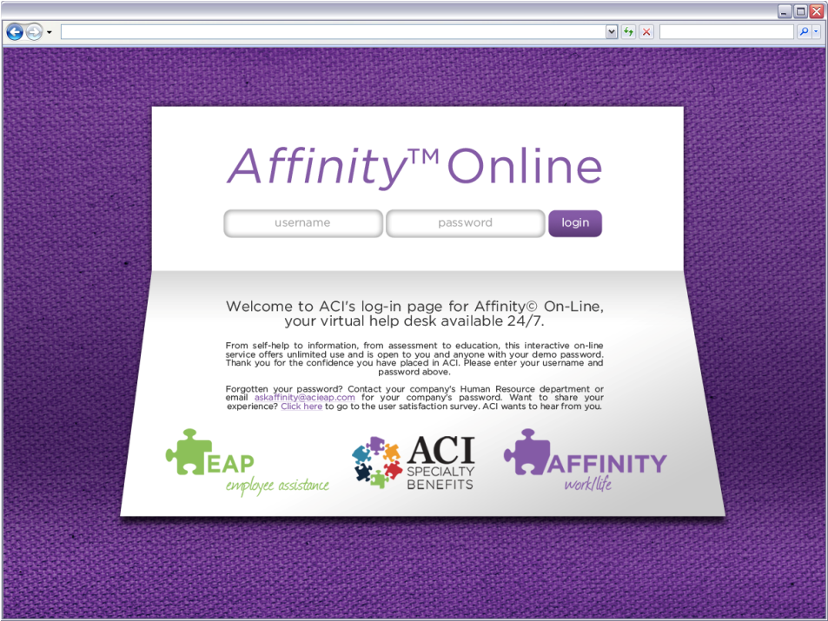
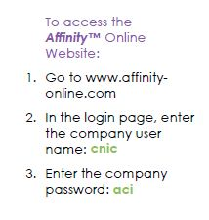
Affinity™ Online
Personalized self-paced assistance
Strategies for better and healthier living
FREE services no matter how often accessed
Help available 24 hours per day, seven days per week
Notes:
Affinity includes:
Enhanced Childcare Services
Enhanced Senior Care Services
Enhanced Legal Services
Educational Opportunity
Pet Care Services
Healthy Literature
Affinity Online

Slide 16
Do you need someone to talk to?
Talk to us!
Multiple resources are available at your fingertips…
Employee link:
http://cnic.acieap.com
Email: eapinfo@acieap.com
Call: 800.932.0034
Notes:
Please do not hesitate to contact us anytime by phone at 800-932-0034 or e-mail at eapinfo@acieap.com. Thank you for your time. ACI looks forward to serving your needs and the needs of your family members.

